Slide 1
Presentation 1 Family Menu ChatBot Analysis Recap
Findings
Termination Reason Analysis (Post-March Data)
Calls where the chatbot was used had a 20% “agent left” termination reason as compared to 1% when the chatbot was not used was we remove all calls that did not have a termination reason
Average duration of calls Analysis
On average, call duration tripled in length during the period when the chatbot was used
Issue
High number of calls with a null termination reason for calls where the chatbot was not used (Could possibly be impacting the real ratio of termination reasons)

Slide 2
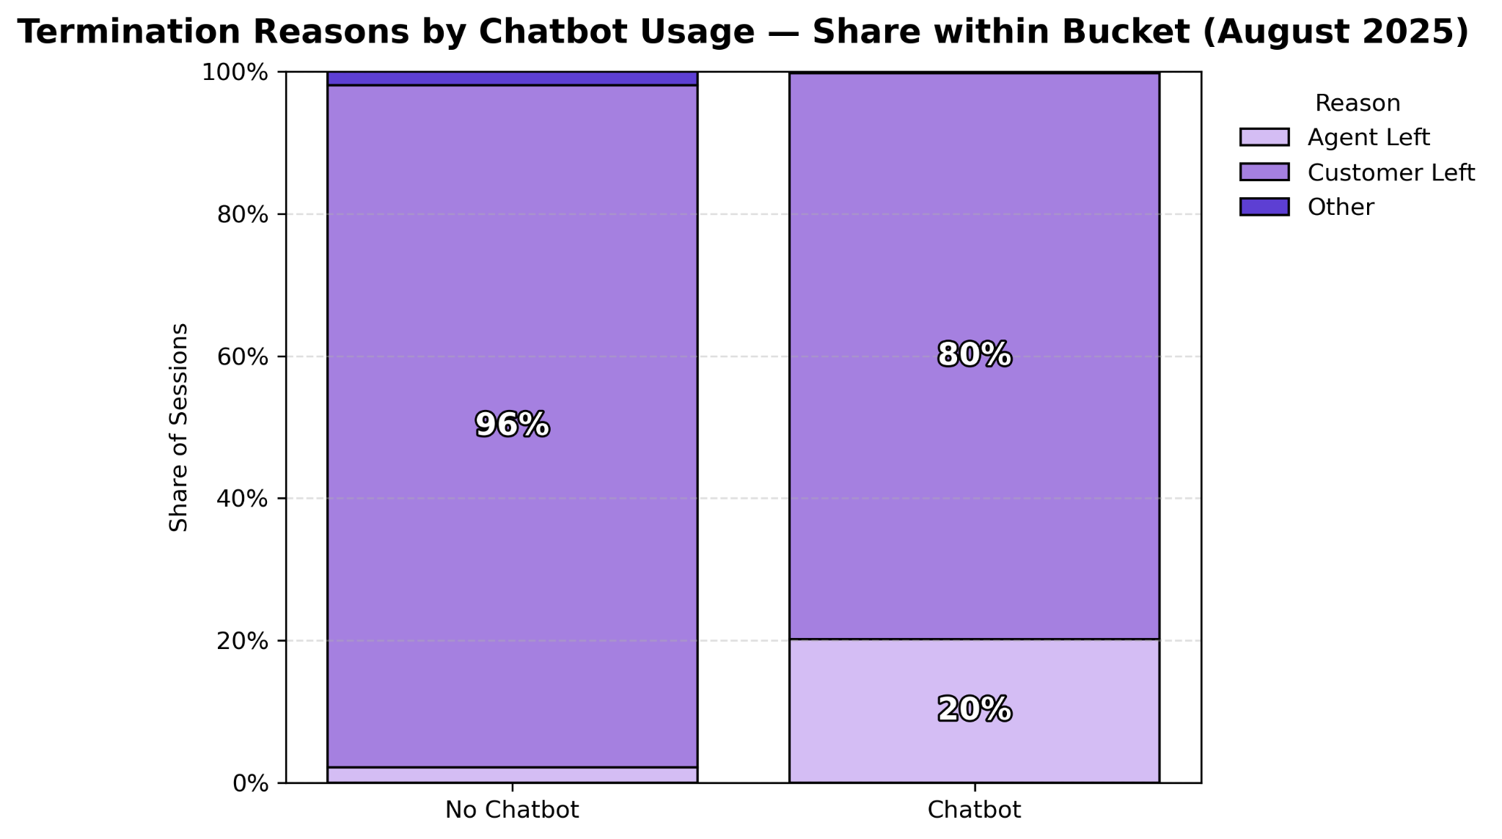
Termination Reason Analysis
The figure describes the termination reasons of calls within the Family Menu during August (by calls that reached the chatbot vs ones that did not)
Takeaway: Calls that reached the chatbot seemed to have a more positive outcome due to the higher proportion of agent ended calls
Next Step: Limit control group to calls that reached a human agent or compare termination reasons during the broad chatbot period vs before/after the chatbot period

Slide 3
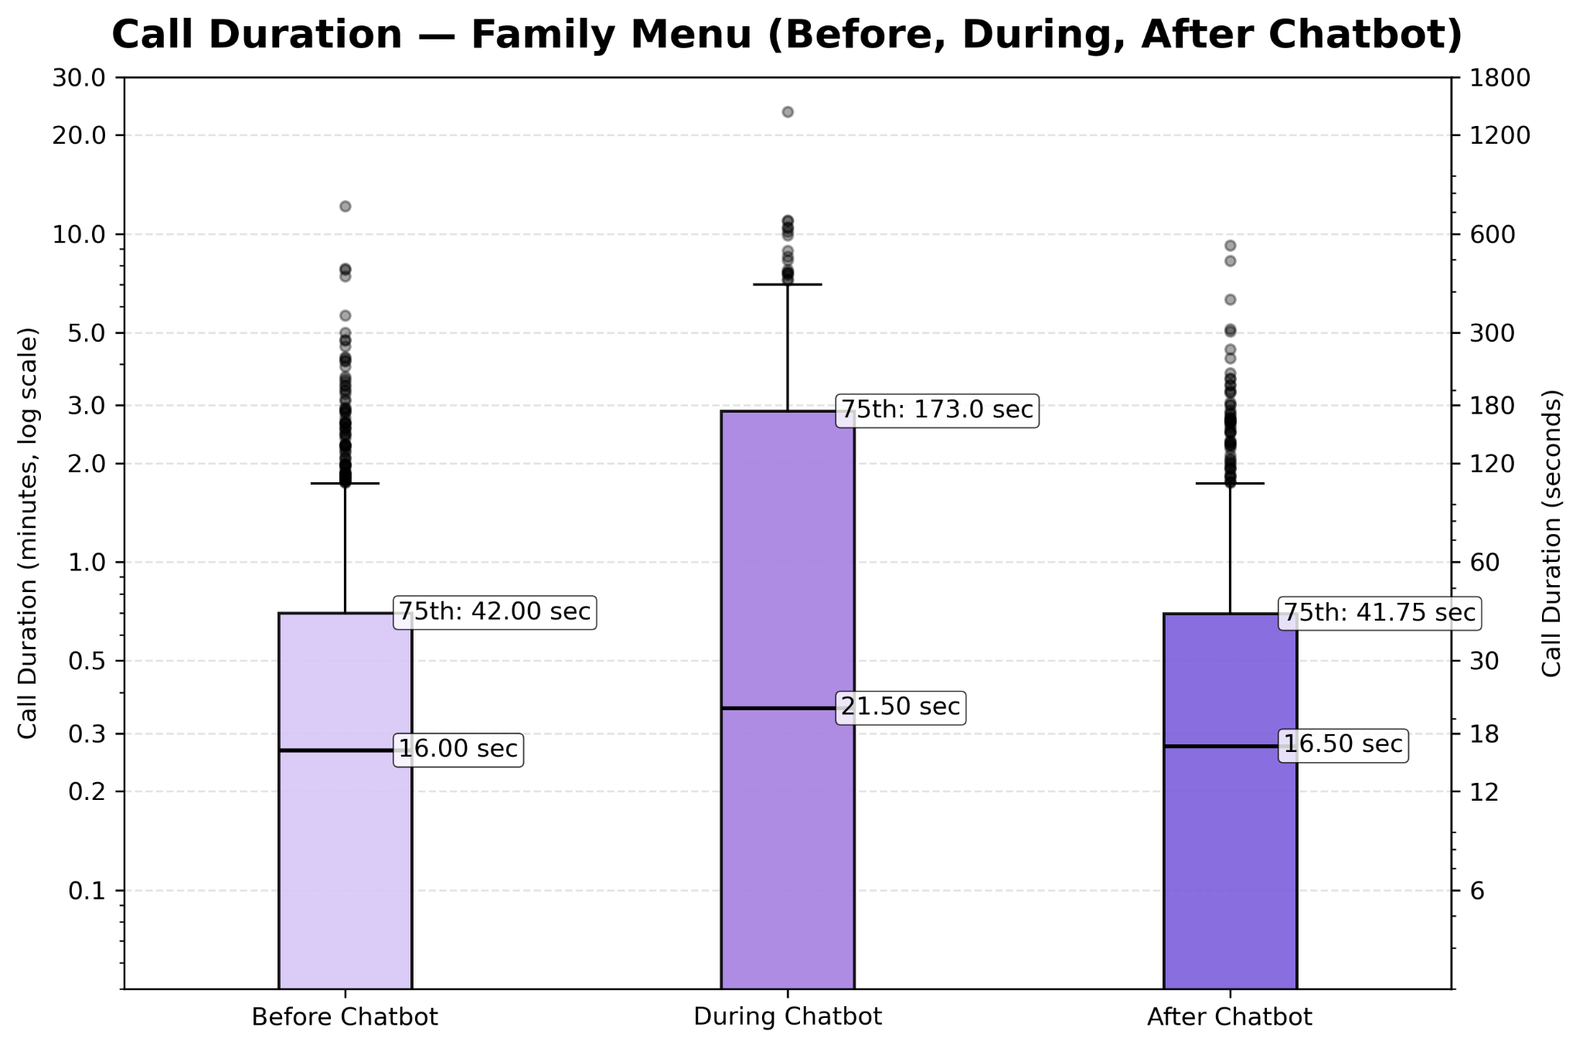
Call Duration Analysis
The figure describes the distribution of call duration within the family menu before/after and during the Chatbot usage period
Takeaway: Calls during the Chatbot’s usage seem to be longer and have a wider range in length

Slide 4
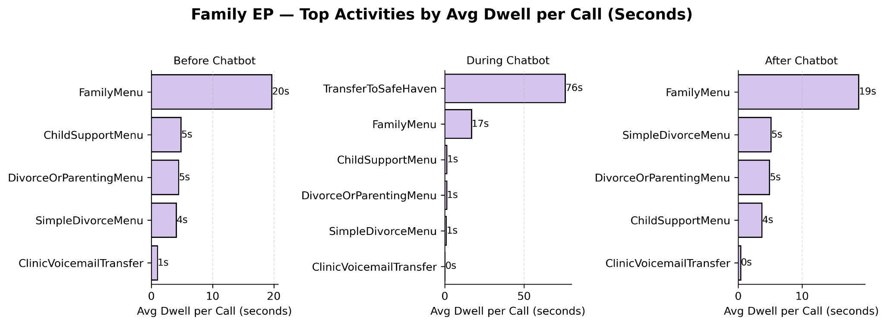
Time Spent within Family Menu
The figure describes the average time spent per call in different activities within the family menu
Takeaway: A majority of the time spent during the chatbot usage period was with the chatbot. There was much less time spent within submenu’s within the family menu

